Slide 1

B.L.D.E.A’s V.P. Dr. P.G. HALAKATTI COLLEGE OF ENGINEERING AND TECHNOLOGY, VIJAYAPUR –586103.
INFORMATION SCIENCE AND ENGINEERING
“CYPHER CAM”
By: D Rahulsingh (2BL18IS013)
Parvat Mukartihal (2BL18IS026)
Guided By: Rahul Ambiger (2BL18IS033)
Prof: Pradeep Deshpande Shraddhanand B (2BL18IS035)

Slide 2
Haar Cascades for Object Detection
Object Detection is a computer technology related to computer vision, image processing and deep learning that deals with detecting instances of objects in images and videos. We will do object detection in this article using something known as haar cascades.
Positive images – These images contain the images which we want our classifier to identify.
Negative Images – Images of everything else, which do not contain the object we want to detect.

Slide 3
Haar Cascades Implementation
import cv2
import numpy as np
import matplotlib.pyplot as plt % matplotlib inline
# Read in the cascade classifiers for face and eyes
face_cascade = cv2.CascadeClassifier('../DATA / haarcascades / haarcascade_frontalface_default.xml')
eye_cascade = cv2.CascadeClassifier('../DATA / haarcascades / haarcascade_eye.xml’)
# create a function to detect face
def adjusted_detect_face(img):
face_img = img.copy()
face_rect = face_cascade.detectMultiScale(face_img,scaleFactor = 1.2,minNeighbors = 5)
for (x, y, w, h) in face_rect:
cv2.rectangle(face_img, (x, y),(x + w, y + h), (255, 255, 255), 10)\
return face_img

Slide 4
Haar Cascades Implementation
# create a function to detect eyes
def detect_eyes(img):
eye_img = img.copy()
eye_rect = eye_cascade.detectMultiScale(eye_img,scaleFactor = 1.2,minNeighbors = 5)
for (x, y, w, h) in eye_rect:
cv2.rectangle(eye_img, (x, y),(x + w, y + h), (255, 255, 255), 10)
return eye_img
# Reading in the image and creating copies
img = cv2.imread('../sachin.jpg')
img_copy1 = img.copy()
img_copy2 = img.copy()
img_copy3 = img.copy()
# Detecting the face
face = adjusted_detect_face(img_copy)
plt.imshow(face)
# Saving the image
cv2.imwrite('face.jpg', face)

Slide 5
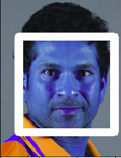
Haar Cascades Implementation
Code : Detecting the face

Slide 6
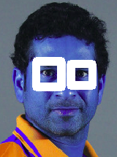
Haar Cascades Implementation
eyes = detect_eyes(img_copy2)
plt.imshow(eyes)
cv2.imwrite('face_eyes.jpg', eyes)
Code : Detecting eyes

Slide 7
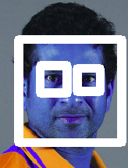
Haar Cascades Implementation
Code : Detecting eyes and faces
Haar Cascades can be used to detect any types of objects as long as you have the appropriate XML file for it. You can even create your own XML files from scratch to detect whatever type of object you want.

Slide 8
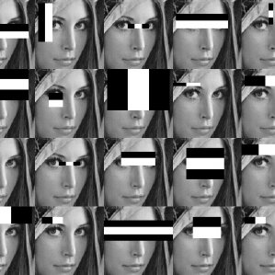
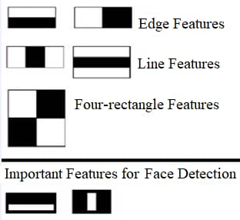
Haar Cascades Implementation

Slide 9
Thank you

